Slide 1
Varun Maddineni
Sai Deepthi Madhira
Manasa Gundaji
Aishwarya (TL)

Slide 2
Java FLP Project
Capgemini MIPL
20th August, 2018

Slide 3
CapStore
(E-Commerce Application)
Notes:
Usar para separador de capitulos . Seria bom ter esta versao em vermelho e verde tb..

Slide 4
CapStore is a web based e-commerce website that allows users to buy or sell products.
CapStore also allows users to sell their products, they need to register on to the website and need to be authorized by the admin of Capstore.
The CapStore Application performs the following
1. Signup, Login or Logout
2. Buy/sell products
3. Give review on products and return them.
4. Merchant- there can be two types of merchants, direct merchant and third party merchant. New merchants can be added or removed by admin. Merchants can add or remove products on CapStore.
5. Items can be added into cart and removed from the cart, after the final submission an invoice will be generated.
6. Customer can pay by different payment options

Slide 5
Project Requirements

Slide 6
Softwares:
Java 10
STS Version: 3.9.4.RELEASE
MySQL 5.5 Command Line Client
HTML 5
CSS 3
BootStrap
JavaScript
JSP
Spring Boot (2.0.4)
Spring Rest
Notes:
Fixar a posicao do titulo – sempre do lado esquerdo.
Sempre que tiver muito texto o coluna deve sempre ser “ narrowed” , se nao fica dificil de ler. Colocar paragrafos no texto.
Linha vertical deve ser mais fina e as pontas NUNCA devem ser arredondadas.

Slide 7
By
VARUN MADDINENI
153045
Managing Cart

Slide 8
Significance of the module:
Customer can Add products to the Cart.
Customer can remove the product at any time he wishes.
Customer can Buy the Product Directly from the product page or add multiple products to the cart.
Notes:
Fixar a posicao do titulo – sempre do lado esquerdo.
Sempre que tiver muito texto o coluna deve sempre ser “ narrowed” , se nao fica dificil de ler. Colocar paragrafos no texto.
Linha vertical deve ser mais fina e as pontas NUNCA devem ser arredondadas.

Slide 9
MANAGING CART
The customer is on the product page and wishes to place an order for the selected product.
The customer either clicks on BUY NOW button or ADD TO CART for the selected product.
If the customer wishes to BUY instantly, an cart Id is generated and he/she is navigated to the shipping details page allowing him/her to give the shipping address details.
If the customer clicks Add to Cart an cart_id is generated and he is navigated to cart page.
In the Cart Page Customer can remove the products or proceed to shipping page.

Slide 10
INTERACTIONS WITH OTHER TABLES
Managing Cart
Cart_
Id
Product_
Id
Customer_
Id
CUSTOMER
Order
Shipping
MERCHANT
Notes:
Fixar a posicao do titulo – sempre do lado esquerdo.
Sempre que tiver muito texto o coluna deve sempre ser “ narrowed” , se nao fica dificil de ler. Colocar paragrafos no texto.
Linha vertical deve ser mais fina e as pontas NUNCA devem ser arredondadas.

Slide 11
Customer
customerId
customerName
phoneNumber
emailId
dateOfBirth
password
addressId
lastLogin
isActive
shippingId
bankId
cartId
feedBackId
returnOrdersId
wishListId
invoiceId
Tables Used
Inventory
productId
category
dateOfInclusion
description
expiryDate
noOfViews
Price
productName
quantity
brandId
couponId
discountId
invoiceProductId
merchantId
ManagingCart
cartId
quantity
status
customerId
productId
orderId

Slide 12
Table 1: Cart
Column_name | Datatype | Constraints | description
Cart_id | int | Primary key
Customer_id | int | Foreign key | Fetch customer details
Inventory_id | Int | Foreign key | Fetch product details
Product_Qty | Int
Price | Int

Slide 13
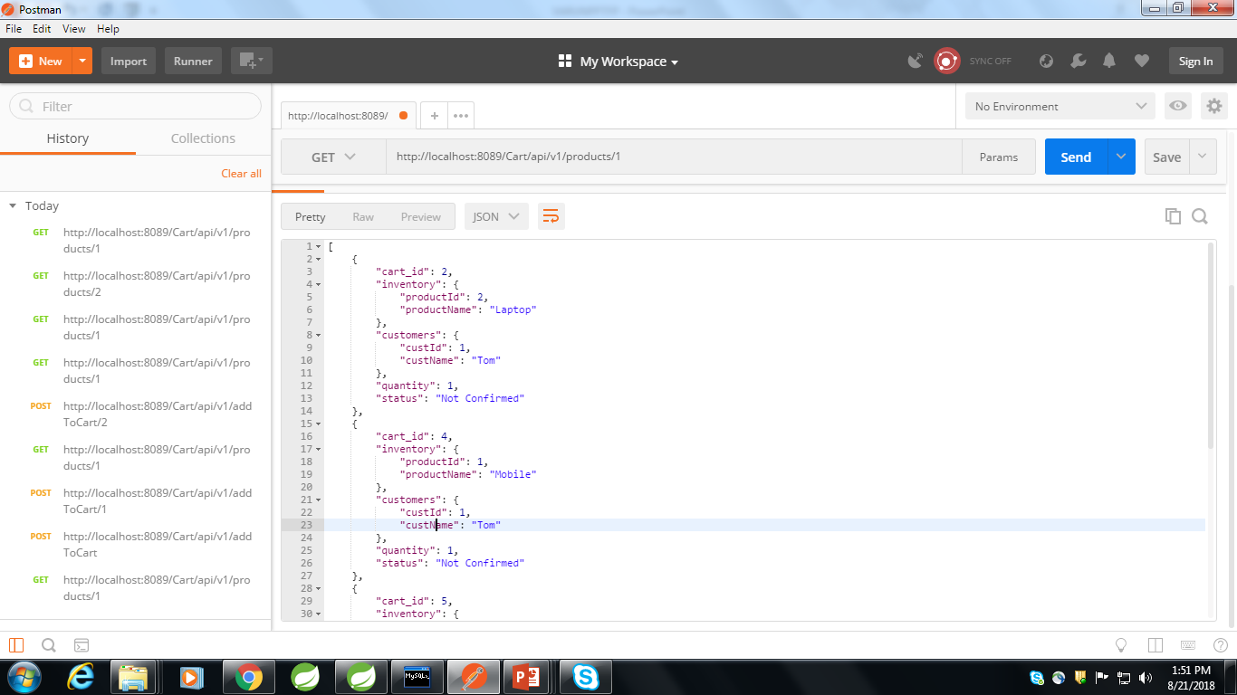

Slide 14
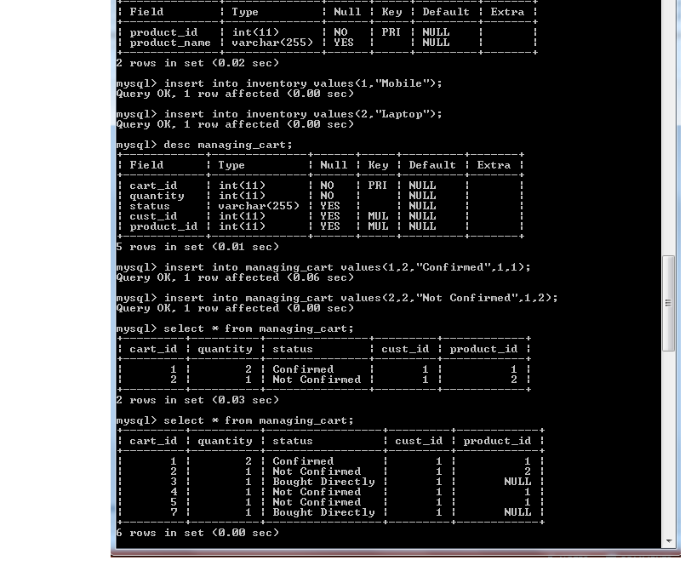

Slide 15
Thank You

